Slide 1
Introduction to Test-Driven Development
Christopher Bartling

Slide 2
Programming is the art of telling another human what one wants the computer to do.
Donald Knuth, Stanford University Professor Emeritus

Slide 3
Why Test-Driven Development?
Unit testing is a design activity of software development.
Clarifies the intent of our code.
Forces you to concentrate on the responsibility assigned to a method or function.
Forces you to solidify contracts between dependencies.
Unit tests communicate the soundness of design decisions.
Unit tests act as executable documentation.
Clean code that works – Ron Jefferies

Slide 4
Benefits of test-driven development
Constantly asking yourself what it is you want to accomplish.
Forces you to deeply contemplate the problem domain.
Make code changes with confidence.
Write better designed code with fewer bugs.
Flexible code that is adaptive to change.
Force you to create smaller functions that do one thing.
Document your code by giving usage examples.
Think twice before adding new features.

Slide 5
Unit testing as a feedback loop
We apply feedback loops to every level of our development.
Unit testing is an excellent feedback loop that occurs within seconds.
Quick execution of a unit test suite provides us with update-to-date information about our codebase.
Constant testing automation (CI build) with a test suite with good test code coverage can catch regression errors during development.
Test-driven development gives us feedback on...
Quality of the implementation (does it work)
Quality of the code design (is it well structured)

Slide 6
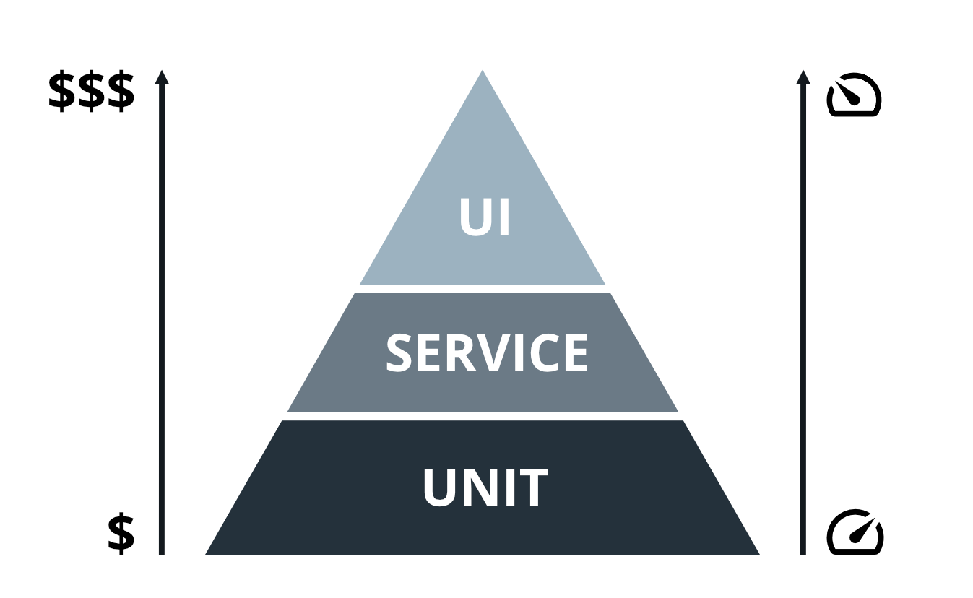
Testing Pyramid

Slide 7
Unit vs. Integration Tests
Isolated methods or functions.
Focus on allocating responsibility.
Execute quickly.
Test doubles usage.
Written along with code, hopefully test-first.
Created and maintained by developers.
Integrate components together.
Connect to databases, caches, messaging systems, external APIs, and other dependencies.
Execution can be slower.
External dependencies can be difficult to control.
Focus on verifying desired functionality.

Slide 8
Unit testing focus
Write unit tests as you write your code for each component.
Focus on collaborator interfaces, the contract between your code and the dependency.
Use unit tests to refactor your code, making it more communicative, more flexible for reuse and more open to adding new functionality.
Not much planning needed to start unit testing.
Unit tests are isolated from external dependencies, so we don’t have to worry about them.
Just Do It!

Slide 9
Integration testing focus
Integration testing happens after you have written your components.
Ensures that the newly created components can be wired together with real dependencies to provide functionality.
Any deviations detected from integration testing can be used to add test coverage at the unit tests level and to influence code design decisions.
Integration testing requires significant planning.
How will dependencies be managed for the integration test suite?
How will state be managed between tests?
How do we test with external dependencies that we cannot control?

Slide 10
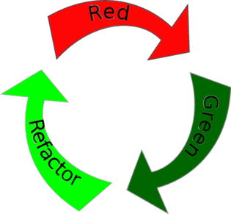
Test-Driven Development Cadence

Slide 11
Test-Driven Development Cadence
Write a failing, high value test.
Demonstrate that it communicates its failure well.
Make the high value test pass by providing implementation code.
The implementation code may be messy at this point.
Run the entire test suite to ensure all tests pass.
Refactor your code, running the test suite after each change.
Determine your next most valuable test, repeating the cycle.

Slide 12
Managing fear during programming
Fear makes you…
Tentative
Communicate less
Avoid feedback
Test-driven development provides us with courage to
Begin learning as quickly as possible
Communicate clearly
Search out concrete, helpful feedback

Slide 13
What makes a good unit test
Tests should be…
Unique
Written at the right level of abstraction
Expressive
Based on acceptance criteria
Implementation independent
Knowing how to write a good test is paramount to being successful with TDD.

Slide 14
Don’t be clever!
Prefer clarity over cleverness.
Developers spend much more time reading code than writing code.
Optimize your source code for reading.
Make your code as easy to understand as you possibly can.
If you encounter code that is not easy to understand, take a little time to refactor it.
“Maintainable code is more important than clever code.” – Guido van Rossum, inventor of the Python language
“Simplicity is a prerequisite for reliability.”- Edsger W. Dijkstra

Slide 15
Accidental vs. essential complexity
Software should behave predictably and accomplish its goals without too many surprises (that is, outages in production).
The number of surprises directly correlates with the amount of unnecessary complexity found in a project.
Accidental complexity relates to problems which engineers create and can fix, [whereas] essential complexity is caused by the problem to be solved, and nothing can remove it – Fred Brooks in his seminal “No Silver Bullet” essay
Push back when accidental complexity is introduced.

Slide 16
Don’t Repeat Yourself (DRY)
Copy-pasta coding
Doing the same or almost the same things in multiple places in the code.
DRY things up! Refactor to reusable behavior.
Less code is easier to maintain and debug.
Small functions are easy to test.
Some development tools detect duplicate code and warn you about it, and some even help you extract methods or functions from the duplications.

Slide 17
YAGNI
Tempting to write some extra code because you think you will need it later on.
This can happen when design simplicity is not followed.
Nobody dares to remove it because who knows what will break if they do.
Unused code does not get updated.
It can introduce bugs and security vulnerabilities that didn’t have to be there in the first place.
Don’t write code that you don’t need right now.
Unit testing ensures that you are solving the problem at hand.

Slide 18
Premature optimization
It is tempting to optimize your code prematurely.
Your code will be less clear to others.
You will spend time on a problem that likely doesn’t exist.
Premature optimization adds complexity and in many cases is unjustified.
Make complexity earn its way into the source code.
You cannot quantify how your code will perform until you run it.
Do not spend time optimizing it until there is an actual problem.
Keep it stupid simple (the new KISS)

Slide 19
Test-driven development mantra
Red: Write a test that doesn't work or perhaps doesn't even compile.
Green: Make the test pass!
Don't worry about code duplication or other code smells at this point.
Refactor: Eliminate code smells and make source code more communicative.
All tests in the test suite must continue to pass successfully.

Slide 20
Minimal APIs
Writing clear, minimal APIs is key to managing simplicity in software systems.
Smaller APIs with fewer methods and arguments are easier to understand and test.
Allow us to put more effort into comprehending the actual problem we set out to solve.
Less is more.

Slide 21
Modularity and decoupling
Breaking problems up into small, manageable components.
Loose coupling
Ability to update parts of a system in isolation is an effective method for increasing developer agility and system stability.

Slide 22
Refactoring
Restructuring your code without changing its behavior.
Software is rarely perfect on the first attempt.
It may work, but it will be messy, and there will be code smells.
Software is continuously evolving.
Work to continuously improve it.
Even if you start with a perfect code base, it can get messy very quickly.
Leave a piece of code better than you found it, every time.
Small improvements over time add up to a codebase that is easy to read and maintain.

Slide 23
Total Cost of Ownership (TCO)
The Total Cost of Ownership (TCO) of enterprise software is the sum of all direct and indirect costs incurred by that software.
Software development is the biggest contributor.
TDD can significantly reduce the Total Cost of Ownership (TCO) of software development projects.
Consider long-term maintenance and evolution.
Technical debt can negatively impact TCO.
Understanding and forecasting the TCO and is a critical part of the Return on Investment (ROI) calculation.

Slide 24
TDD vs ATDD
TDD
ATDD
Focus on individual methods and functions
Written by developers
Tests are isolated and use test doubles for dependency isolation
Tests execute quickly (ms)
Easy to test exceptional pathways through the code
Focus on scenarios
Written by quality assurance and potentially developers
Tests integrate the entire stack of components together
Tests require setup and can be slower to execute (seconds)
More difficult to simulate exceptional scenarios

Slide 25
Further reading
Test-Driven Development: By Example by Kent Beck
Working Effectively with Legacy Code by Michael C. Feathers
Growing Object-Oriented Software, Guided by Tests by Steve Freeman and Nat Pryce
Beyond Legacy Code by David Scott Bernstein

